Slide 1
JavaScript Object Notation (JSON)
Introduction to JSON | JSON structure and Values | Working With JSON | Extending and Customizing JSON Output
Notes:
Welcome to our lecture on JavaScript Object Notation. In this lecture we will go through introduction to JSON, JSON structure and values, working with JSON, extending and customizing JSON output. Let’s start the video lecture.

Slide 2

Introduction to JSON
JSON for Data Exchange: A structured format that replaces unstructured text and complex XML.
Human & Machine Readable: Easy to debug and interpret by both developers and computers.
Efficient & Fast: Enables quick transmission and parsing, making it the standard for web communication.
Notes:
JSON, or JavaScript Object Notation, is a widely used format for data exchange. It provides a structured way to store and transmit data, replacing complex XML. JSON is both human and machine-readable, making it easy to debug and interpret. Its efficiency and speed make it the preferred format for web communication, ensuring quick data transmission and parsing.

Slide 3
JSON Structure and Values
String: Unicode text in "", with special characters escaped (e.g., \n, \t, \\).
Number: Integers or decimals (e.g., 42, 3.141, -1.1e-5).
Object: {} with key-value pairs ("key": value), keys must be strings.
Array: [] with ordered values (e.g., [13, "blue"]).
Boolean: true or false.
null: Represents "nothing."
Notes:
JSON data consists of different types of values. Strings are text enclosed in double quotes and can include special characters. Numbers can be integers or decimals. Objects store key-value pairs where keys must be strings. Arrays hold ordered values like numbers or text. Boolean values are either true or false, and null represents the absence of a value. These data types make JSON flexible and easy to use.

Slide 4
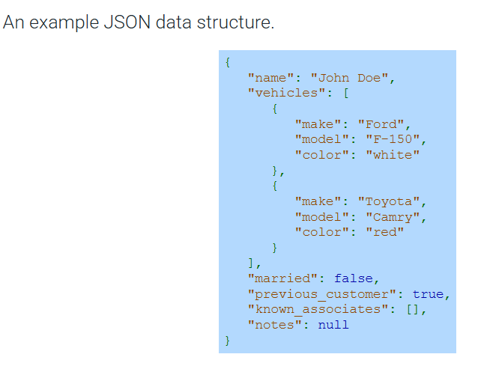
Example
Notes:
This is an example of a JSON data structure. It represents a person named John Doe with multiple attributes. The vehicles key holds an array of objects, each representing a car with make, model, and color. Boolean values indicate marital status and customer history. An empty array shows no known associates, and null represents missing notes. This structure shows how JSON organizes complex data efficiently.

Slide 5
Working with JSON
JSON.parse() – Converts a JSON string into a JavaScript object (e.g., '[1,"two",null]' → [1,"two",null]). Used for server data.
JSON.stringify() – Converts a JavaScript object into a JSON string. Used for sending data to a server. (e.g., new Date('2020-08-06') → "2020-08-06T00:00:00.000Z").
Notes:
Working with JSON in JavaScript involves two key methods. JSON.parse converts a JSON string into a JavaScript object, allowing us to work with server data. JSON.stringify does the opposite, converting a JavaScript object into a JSON string, which is useful for sending data to a server. These methods enable smooth communication between applications, making JSON a standard format for data exchange.

Slide 6
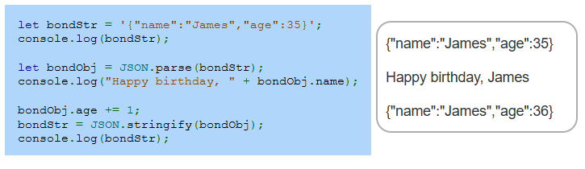
Example
Notes:
This example demonstrates JSON.parse and JSON.stringify in action. First, we have a JSON string representing a person named James with an age of 35. Using JSON.parse, we convert it into a JavaScript object, allowing us to access and modify properties. After increasing the age by one, we convert it back into a JSON string using JSON.stringify. This process is essential for handling dynamic data in web applications.

Slide 7
Extending and customizing JSON output
JSON.parse() Reviver: Modifies parsed values (e.g., converts "2010-12-30" to a Date object).
JSON.stringify() Replacer: Customizes output; can filter properties or transform data (e.g., ["a","b"] includes only selected keys).
JSON.stringify() Spacer: Adds indentation for readability (e.g., " " adds two spaces per level).
Notes:
So far, we have seen how to work with JSON using parse and stringify. But JSON also allows customization. The reviver function in JSON.parse modifies values while parsing, such as converting dates. The replacer in JSON.stringify filters or transforms data before converting. Finally, the spacer option adds indentation, making the output more readable. These features make JSON even more powerful.

Slide 8
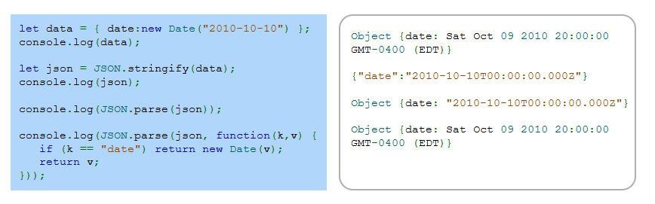
Example
Notes:
In the previous slide, we discussed how JSON dot parse can modify values using a reviver function. Here, we see an example with dates. Initially, a date object is created and converted into a JSON string. However, when parsed back, the date is treated as a string. To fix this, a reviver function is used to detect the date key and convert it back into a Date object, ensuring proper data handling in JavaScript. Thanks for watching the lecture.

